Slide 1

Frequency Support Mechanisms in Electricity Grid and Wind Turbine Applications
Erencan Duymaz
Tuesday, October 13th, 2017

Slide 2
About Me
Education
BSc. Electrical and Electronics Engineering METU
Power Systems and Power Electronics 2010-2016
MSc. Electrical and Electronics Engineering METU
Power Electronics and Electric Machines 2016-2018 (Expected)
Work Experience
Researcher at PowerLab Research Group
Aug 2016 - Present

Slide 3
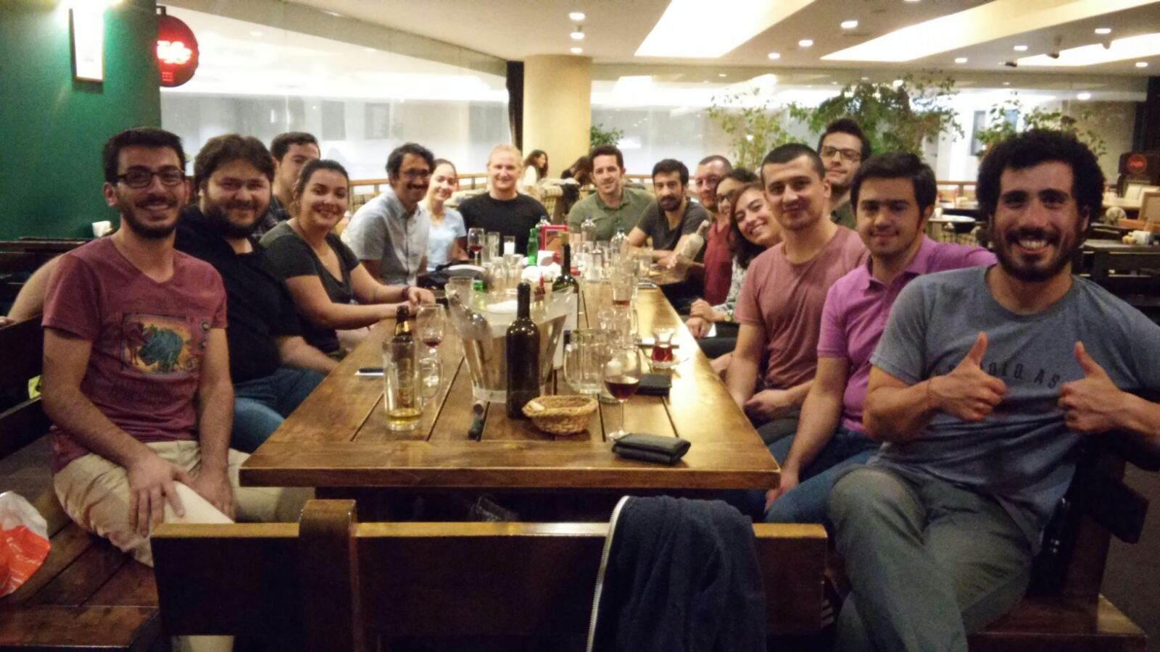
About PowerLab

Slide 4
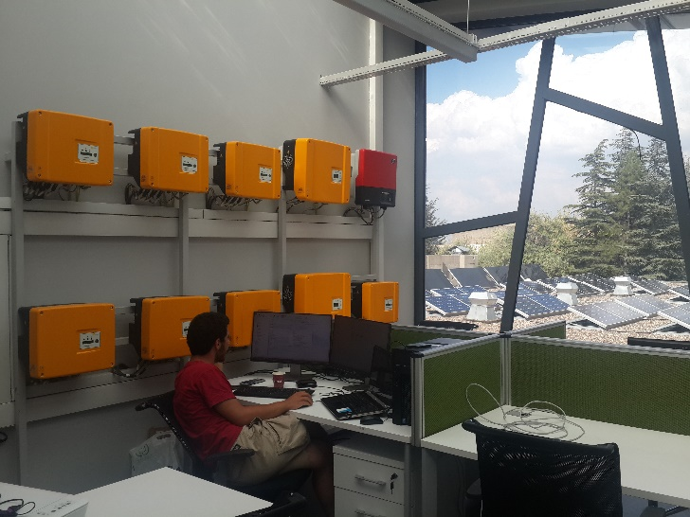
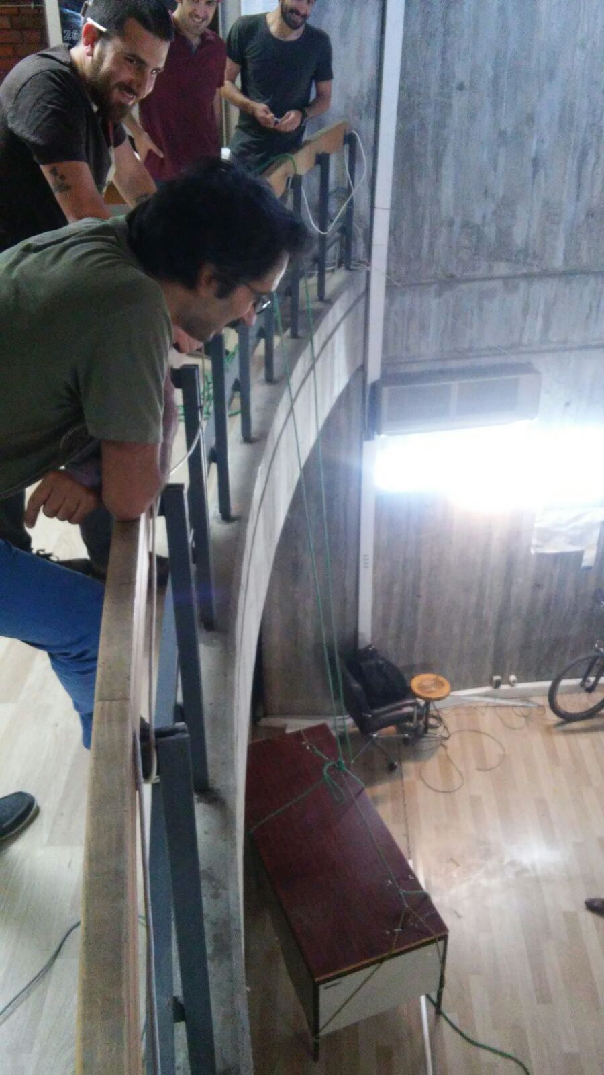
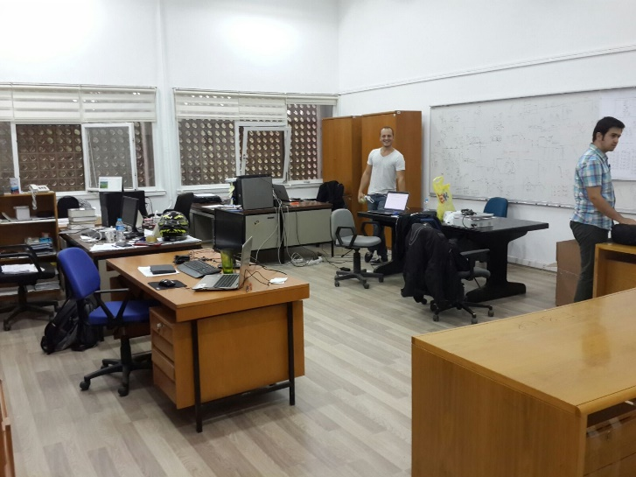
About PowerLab
ARC-300
C-114
E-101

Slide 5
Outline
Renewable Energy Today
Renewable Energy Challenges
Frequency Responses
Synthetic Inertia Implementation in Wind Turbines
Other Applications

Slide 6

Renewable Energy Today
EU target for 20% energy from renewable sources in gross final consumption for 2020. (2004)
National Action Plans which are ranging from 10% in Malta to 49% in Sweden. (2009)

Slide 7
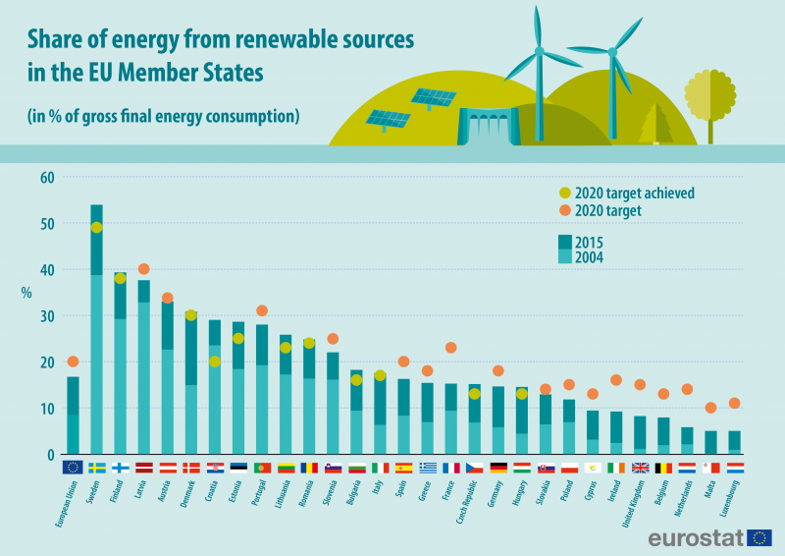
Renewable Energy Today
11 EU countries have already reached 2020 targets!!!

Slide 8
Renewable Energy Challenges
Uncertain Power Generation Profile
No Primary or Secondary controls
In the past;
Government buys whatever they generate
Free to disconnect
No ancillary services

Slide 9
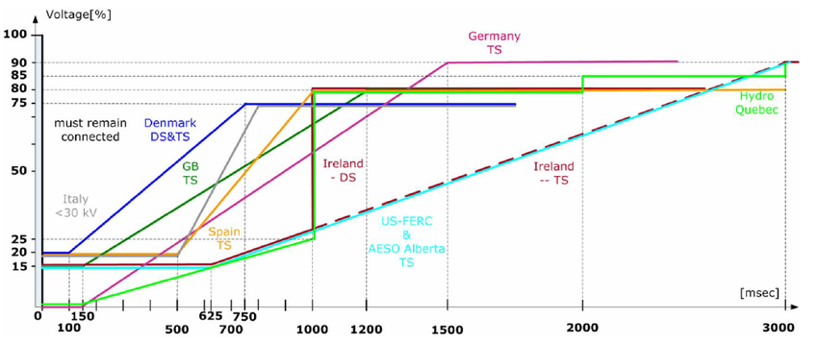
Renewable Energy Challenges
LVRT requirements for different countries

Slide 10
How Frequency changes in grid?

Slide 11
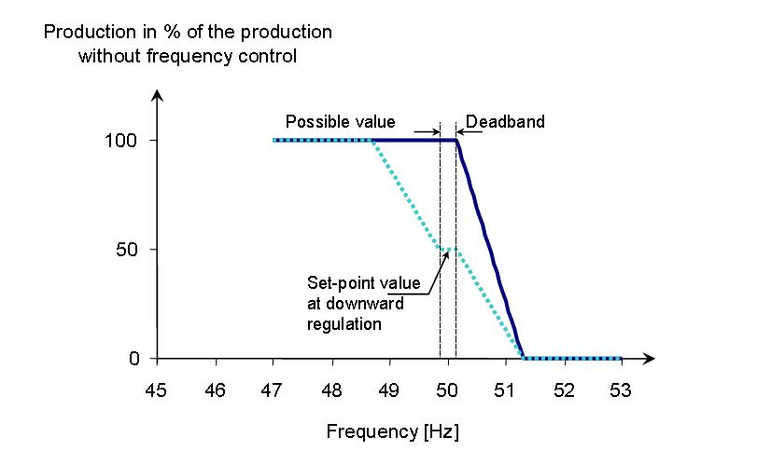
Renewable Energy Challenges
Active Power Curtailment for High Frequencies

Slide 12
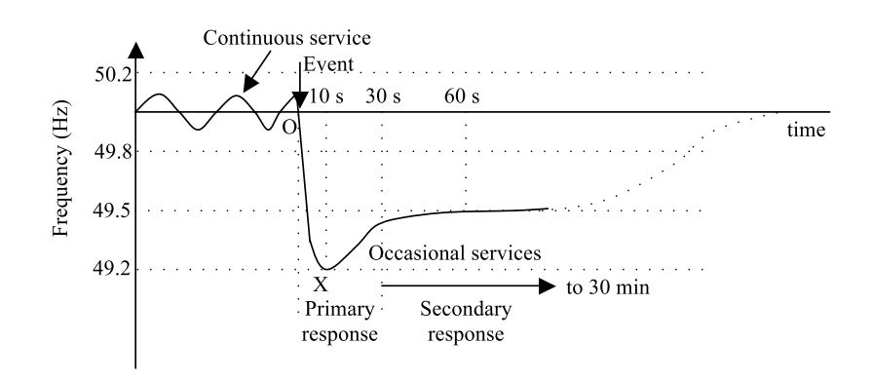
Frequency Regulating Mechanisms in Grid
Inertial Response, Primary and Secondary Responses

Slide 13
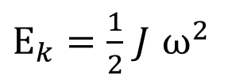
Inertia
Inertia = “resistance to change”
Proportional to rotating masses in the power system
Prevents the grid frequency from changing suddenly due to the inherent power release from the kinetic energy of synchronous generators.
$E_{k}=\frac{1}{2}$ $J$ $ω^{2}$
Notes:
A successful engineer must be able to communicate his findings and ideas to others.
Engineers are in need of communication more than most other professionals.
Clear presentations and reports brings an engineer to the attention of the project leader and management.
The purpose : transmission & reception of information
It is most important not to disregard the receiver of information.
Information must be in a form that can be understood by the receiver.

Slide 14
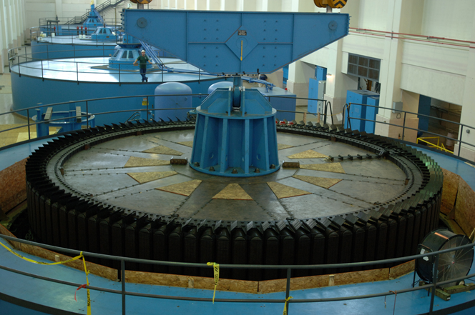
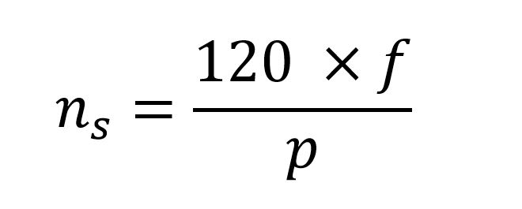
Frequency vs Synchronous Speed
Synchronous generators ‘inherently’ support the frequency with their inertia!

Slide 15
Frequency Regulating Mechanisms in Grid

Slide 16
Summary so far;
Primary and Secondary Controllers in the grid adjust the frequency!
Primary Controllers acts within a few seconds!
Until the primary controller action frequency decline is arrested by inertial response of the grid!
Larger grid inertia results lower frequency dips and lower ROCOF (rate of change of frequency)

Slide 17
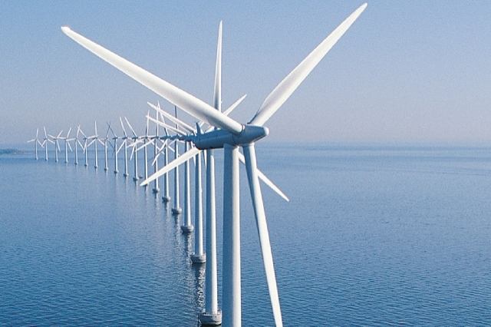

What is the problem with Renewable?
Aggravated grid inertia is decreasing with the increasing renewable penetration!

Slide 18
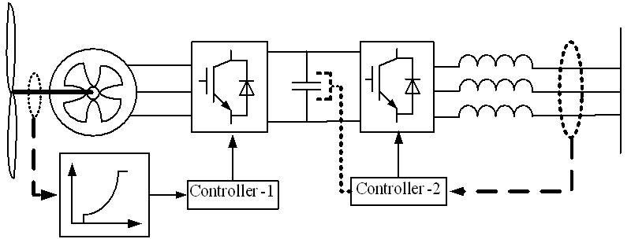
Renewable Sources

Slide 19
Solution : Synthetic Inertia
Frequency is monitored!
Decrease speed
Inject more power to arrest the frequency decrease!

Slide 20
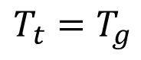
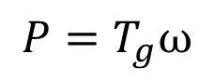
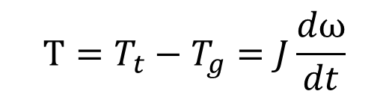
Solution : Synthetic Inertia
$$T_{t}=T_{g}$$
$$T=T_{t}−T_{g}=J\frac{dω}{dt}$$
$$P=T_{g}ω$$
It is possible to increase active power but how much?

Slide 21
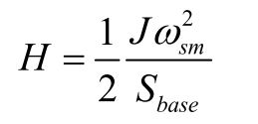
Definition: Inertia Constant (s)
Simply, how many seconds you can supply power by using your kinetic energy!
Generator inertia constants vary between 2-9 seconds.
One can imitate a synchronous generator behaviour with desired inertia constant!

Slide 22
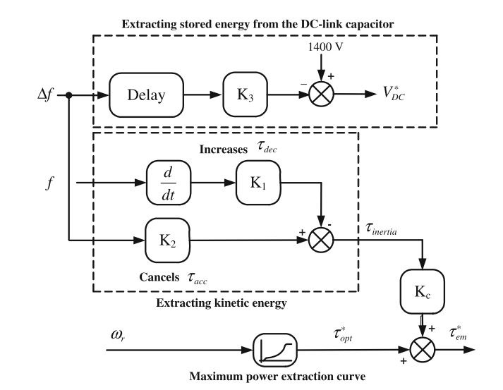
Solution : Synthetic Inertia
Control Diagram of the Frequency Based Inertial Control

Slide 23

Synthetic inertia:
You can imitate the synchronous generator behaviour in the renewables.
All you need is spare energy!
$$P_{add}=\frac{ΔE}{Δt}$$

Slide 24
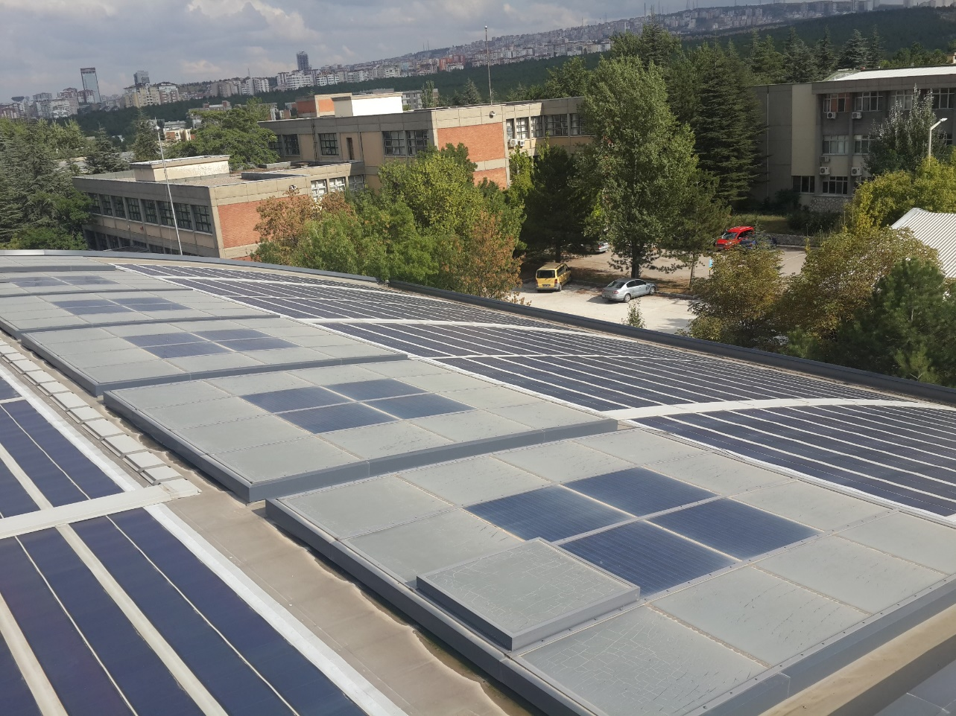
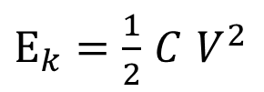
Other Applications-Photovoltaic Systems
$E_{k}=\frac{1}{2}$ $C$ $V^{2}$

Slide 25
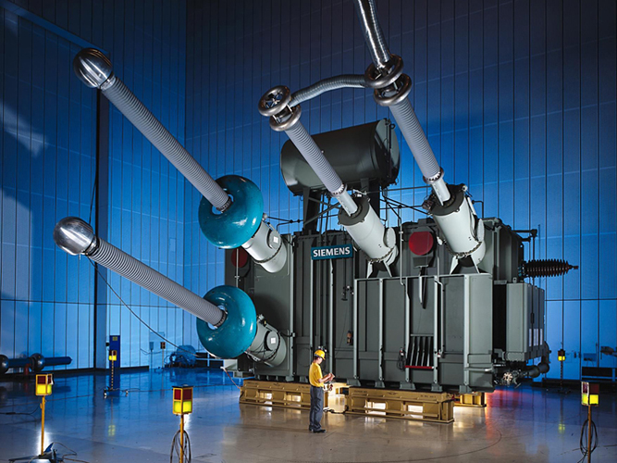

Other Applications-HVDC Transformers
Between Countries such as Turkey-Georgia
Between Offshore WTs and the substations in the land

Slide 26
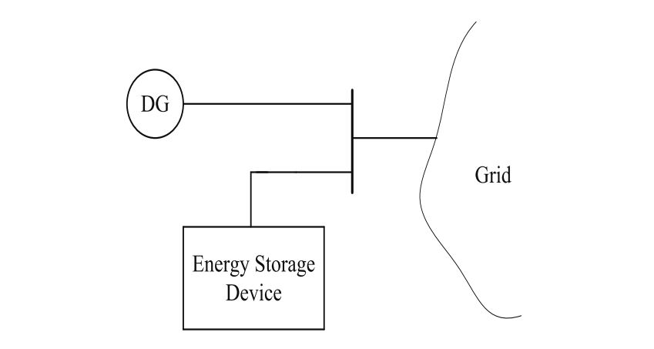
Other Applications-Energy Storage Devices
Battery
Flywheel

Slide 27
Conclusion
Renewable Energy and its challenges
Frequency Regulating Mechanisms
Synthetic Inertia in Wind Turbines
Other Applications

Slide 28
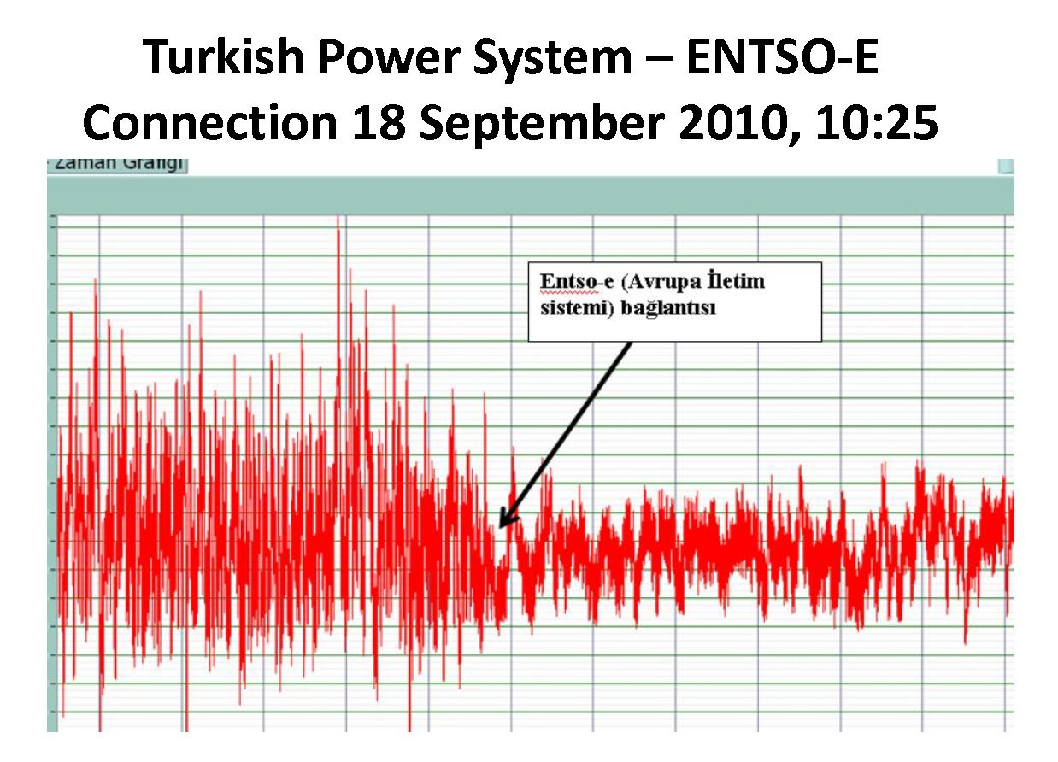
Connection of Turkish Power System to Europe

Slide 29
References
J. Castelló, J. M. Espí, and R. García-Gil, “Development details and performance assessment of a Wind Turbine Emulator,” Renew. Energy, vol. 86, pp. 848–857, 2016.
A. Ulbig, T. S. Borsche, and G. Andersson, “Analyzing Rotational Inertia, Grid Topology and their Role for Power System Stability,” IFAC-PapersOnLine, vol. 48, no. 30, pp. 541–547, 2015.
N. Güven, “INTRODUCTION TO POWER SYSTEMS ” EE 472 POWER SYSTEM ANALYSIS II

Slide 30

Thank you!

